Slide 1
Introduce Yourself to Your Students
Create an introduction slide
Get to know your students and them you!
Studies show that positive teacher-student relationships enhanced nearly every measurable aspect of academic success.

Slide 2
Introduce Yourself to Your Students
Things you can include on your slide:
First name
Where you are from
Something interesting about you
Your experience with teaching, learning Spanish, travelling, etc.
Personalize your slide by adding pictures, color, changing fonts, etc.
Please share this slide for the first few weeks of your class.

Slide 3
Introduce Yourself to Your Students
Don't have PowerPoint or a way to
create an introduction slide?
Let your coordinator know and we can help!

Slide 4
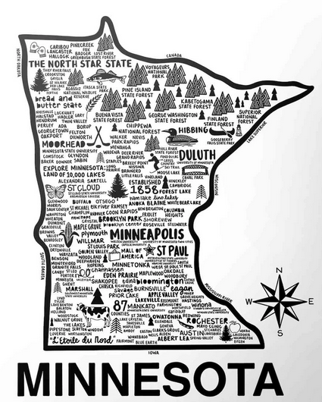
(Example Slide) Hello and Welcome!
My name is Trisha.
I am from Minnesota.
I am your English teacher on Monday nights.
I have 12 years of experience teaching English.
I have a chihuahua named Gremmy. He is from the Dominican Republic.
I learned to make tostones (fried plantain) in the Dominican Republic.
I am a student at Hamline University in St. Paul.

Slide 5
INTRODUCTION SLIDE
List a few of your hobbies
Share your favorite kind of vacation
About you

Slide 6
INTRODUCTION SLIDE
ABOUT YOU

Slide 7
INTRODUCTION sLIDE
ABOUT YOU

Slide 8
INTRODUCTion slide
ABOUT YOU

